Slide 1

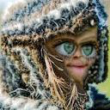
Announcements
HW5 is out tonight.
Due next Wednesday.
Image resizing program (see right).
Lab15, HW6 and HW7 are opportunities to replace earlier HWs or labs that you missed or did poorly on.
Due Friday of RRR week.
Only necessary if you need more points, since we drop two lowest homeworks of 7.

Slide 2
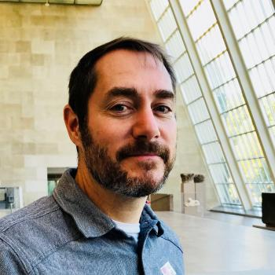
Announcement #2
We have a guest lecturer today: Dr. Chris Gregg of Stanford University (he’s also a Commander in the Navy Reserves).
Chris’s slides are available at this link.

